Slide 1

BASICS OF SQL -- Nakul Khelkar

Slide 2


AGENDAS:
Introduction to SQL-What Is SQL & Database
Data Types, Primary-Foreign Keys & Constraints
Install postgresql and SQLPLUS
Create Table In SQL & Create Database
INSERT UPDATE, DELETE & ALTER Table
SELECT Statement & WHERE Clause with Example
Functions in SQL
Aggregate Functions – Types & Syntax
Group By and Having Clause
SQL JOINS – Types & Syntax
SELF JOIN, UNION & UNION ALL

Slide 3
WHAT IS SQL & DATABASE- INTRODUCTION

Slide 4

What is SQL
It’s applications
SQL v/s NoSQL
Types of SQL Commands
What is Database
Excel v/s Database in SQL

Slide 5





SQL (Structured Query Language) is a programming language used to interact with database

Slide 6



Slide 7

Relational Database | Non-Relational Database
SQL database | NoSQL database
Data stored in tables | Data stored are either key-value pairs, document-based, graph databases or wide- column stores
These databases have fixed or static or predefined schema | They have dynamic schema
Low performance with huge volumes of data | Easily work with huge volumes of data
Eg: PostgreSQL, MySQL, MS SQL Server | Eg: MongoDB, Cassandra, Hbase

Slide 8




Database is a system that allow users to store and organise data

Slide 9

Excel | Database
Easy to use- untrained person can work | Trained person can work
Data stored less data | Stores large amount of data
Good for one time analysis, quick charts | Can automate tasks
No data integrity due to manual operation | High data integrity
Low search/filter capabilities | High search/filter capabilities

Slide 10



Slide 11

There are mainly 3 types of SQL commands:
DDL (Data Definition Language): create, alter, and drop
DML (Data Manipulation Language): select, insert, update and delete
DCL (Data Control Language): grant and revoke permission to users

Slide 12
DATA TYPES, PRIMARY & FOREIGN KEYS, CONSTRAINTS

Slide 13

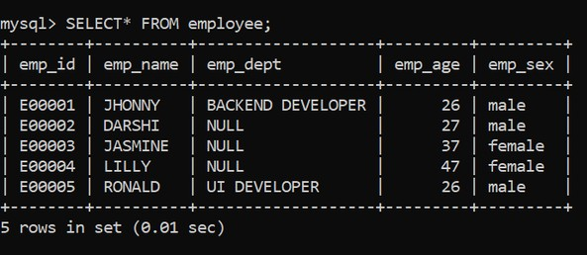
Example
Database
Columns
Tables
Data
(Rows & Columns)
Rows
RDBMS

Slide 14

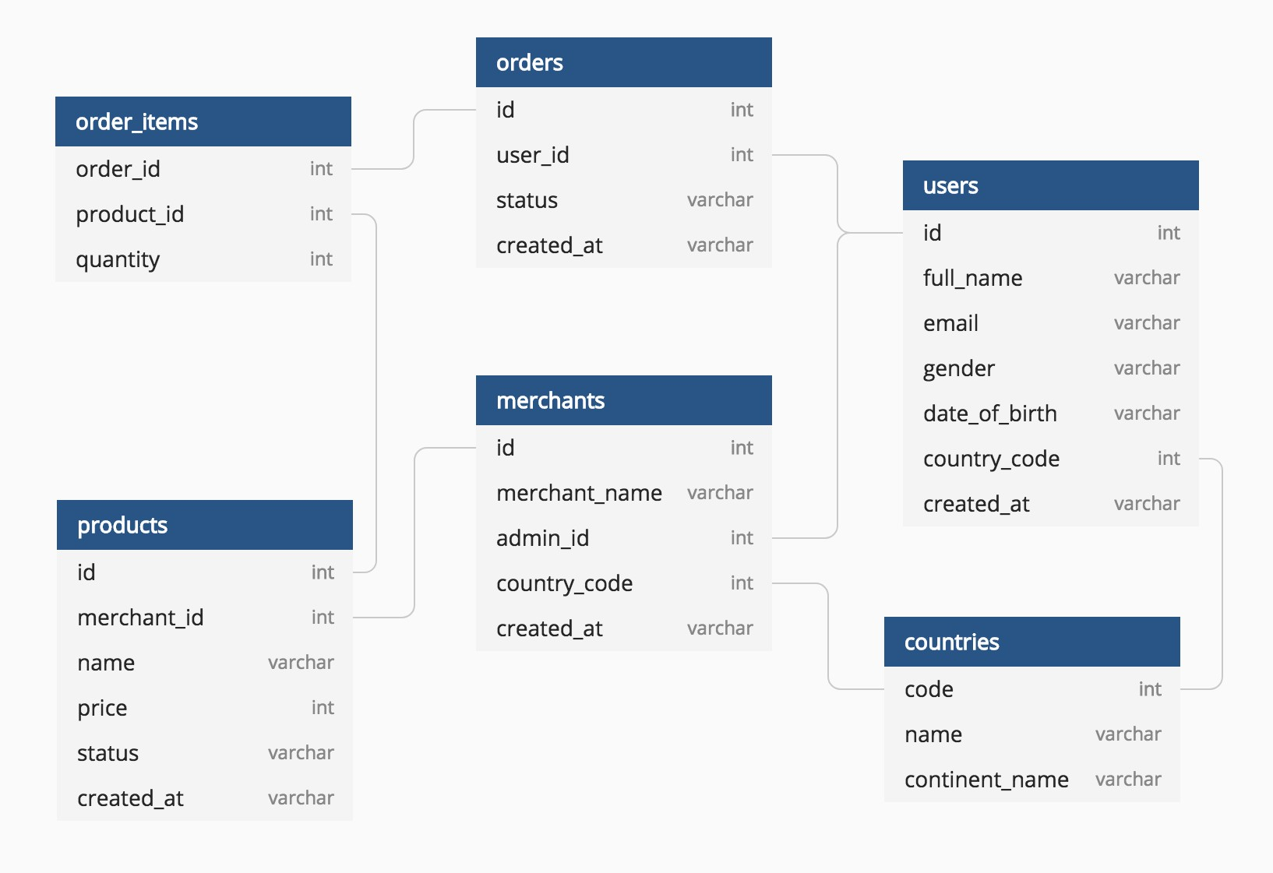
Example

Slide 15











•
•
•
•
•
•
•
•
•
•
•

Slide 16

Data type of a column defines what value the column can store in table
Defined while creating tables in database
Data types mainly classified into three categories + most used
oString: char, varchar, etc
oNumeric: int, float, bool, etc
oDate and time: date, datetime, etc

Slide 17
int: used for the integer value
float: used to specify a decimal point number
bool: used to specify Boolean values true and false
char: fixed length string that can contain numbers, letters, and special characters
varchar: variable length string that can contain numbers, letters, and special characters
date: date format YYYY-MM-DD
datetime: date & time combination, format is YYYY-MM-DD hh:mm:ss

Slide 18



A Primary key is a unique column we set in a table to easily identify and locate data in queries
A table can have only one primary key, which should be unique and NOT NULL
A Foreign key is a column used to link two or more tables together
A table can have any number of foreign keys, can contain duplicate and NULL values

Slide 19

Constraints are used to specify rules for data in a table
This ensures the accuracy and reliability of the data in the table
Constraints can be specified when the table is created with the CREATE TABLE statement, or
after the table is created with the ALTER TABLE statement
Syntax
CREATE TABLE table_name ( column1 datatype constraint, column2 datatype constraint, column3 datatype constraint,
....
);

Slide 20
NOT NULL - Ensures that a column cannot have a NULL value
UNIQUE - Ensures that all values in a column are different
PRIMARY KEY - A combination of a NOT NULL and UNIQUE
FOREIGN KEY - Prevents actions that would destroy links between tables (used to link multiple tables together)
CHECK - Ensures that the values in a column satisfies a specific condition
DEFAULT - Sets a default value for a column if no value is specified
CREATE INDEX - Used to create and retrieve data from the database very quickly

Slide 21
Creating Database & Tables

Slide 22

The CREATE TABLE statement is used to create a new table in a database
Syntax
CREATE TABLE table_name
(
column_name1 datatype constraint, column_name2 datatype constraint, column_name3 datatype constraint,
);
Example
CREATE TABLE customer
(
CustID int8 PRIMARY KEY,
CustName varchar(50) NOT NULL, Age int NOT NULL,
City char(50),
Salary numeric
);

Slide 23

Insert, Update, Delete Values in Table
+
Alter, Drop & Truncate Table

Slide 24

The INSERT INTO statement is used to insert new records in a table
Syntax
INSERT INTO TABLE_NAME
(column1, column2, column3,...columnN) VALUES
(value1, value2, value3,...valueN);
Example
INSERT INTO customer
(CustID, CustName, Age, City, Salary)
VALUES
(1, ‘Sam’, 26, ‘Delhi’, 9000),
(2, ‘Ram’, 19, ‘Bangalore’, 11000),
(3, ‘Pam’, 31, ‘Mumbai’, 6000),
(4, ‘Jam’, 42, ‘Pune’, 10000);

Slide 25

The UPDATE command is used to update existing rows in a table
Syntax
UPDATE TABLE_NAME
SET “Column_name1” = ‘value1’, “Column_name2” = ‘value2’ WHERE “ID” = ‘value’
Example
UPDATE customer
SET CustName = 'Xam’, Age= 32
WHERE CustID = 4;

Slide 26

The ALTER TABLE statement is used to add, delete, or modify columns in an existing table
ALTER TABLE - ADD Column Syntax
ALTER TABLE table_name
ADD COLUMN column_name ;
ALTER TABLE - DROP COLUMN Syntax
ALTER TABLE table_name
DROP COLUMN column_name;
ALTER TABLE - ALTER/MODIFY COLUMN Syntax
ALTER TABLE table_name
ALTER COLUMN column_name datatype;

Slide 27

The DELETE statement is used to delete existing records in a table
Syntax
DELETE FROM table_name WHERE condition;
Example
DELETE FROM customer WHERE CustID = 3;

Slide 28

The DROP TABLE command deletes a table in the database
Syntax
DROP TABLE table_name;
The TRUNCATE TABLE command deletes the data inside a table, but not the table itself
Syntax
TRUNCATE TABLE table_name;

Slide 29
SELECT & WHERE CLAUSE

Slide 30
CREATE TABLE classroom
(
rollno int8 PRIMARY KEY, name varchar(50) NOT NULL, house char(12) NOT NULL,
grade char(1)
);
INSERT INTO classroom (rollno, name, house, grade) VALUES
(1, ‘Sam’, ‘Akash’, ‘B’),
(2, ‘Ram’, ‘Agni’, ‘A’),
(3, ‘Shyam’, ‘Jal’, ’B’),
(4, ‘Sundar’, ‘Agni’, ’A’),
(5, ‘Ram’, ‘Yayu’, ‘B’);

Slide 31

The SELECT statement is used to select data from a database.
Syntax
SELECT column_name FROM table_name;
To select all the fields available in the table
Syntax
SELECT * FROM table_name;
To select distinct/unique fields available in the table
Syntax
SELECT DISTINCT Column_name FROM table_name;

Slide 32

The WHERE clause is used to filter records.
It is used to extract only those records that fulfill a specified condition
Syntax
SELECT column_name FROM table_name
WHERE conditions;
Example
SELECT name FROM classroom
WHERE grade=‘A’;

Slide 33


The LIMIT clause is used to set an upper limit on the number of tuples returned by SQL.
Example: below code will return 5 rows of data SELECT column_name FROM table_name LIMIT 5;
The ORDER BY is used to sort the result-set in ascending (ASC) or descending
order (DESC).
Example: below code will sort the output data by column name in ascending order
SELECT column_name FROM table_name
ORDER BY column_name e ASC;

Slide 34
STRING FUNCTION

Slide 35

Functions in SQL are the database objects that contains a set of SQL statements to perform a specific task. A function accepts input parameters, perform actions, and then return the result.
Types of Function:
System Defined Function : these are built-in functions
Example: rand(), round(), upper(), lower(), count(), sum(), avg(), max(), etc
User-Defined Function : Once you define a function, you can call it in the same way as the built-in functions

Slide 36
String functions are used to perform an operation on input string and return an output string
UPPER() converts the value of a field to uppercase
LOWER() converts the value of a field to lowercase
LENGTH() returns the length of the value in a text field
SUBSTRING() extracts a substring from a string
NOW() returns the current system date and time
FORMAT() used to set the format of a field
CONCAT() adds two or more strings together
REPLACE() Replaces all occurrences of a substring within a string, with a new substring
TRIM() removes leading and trailing spaces (or other specified characters) from a string

Slide 37
AGGREGATE FUNCTION

Slide 38
Aggregate function performs a calculation on multiple values and returns a single value.
And Aggregate functiona are often used with GROUP BY & SELECT statement
COUNT() returns number of values
SUM() returns sum of all values
AVG() returns average value
MAX() returns maximum value
MIN() returns minimum value
ROUND() Rounds a number to a specified number of decimal places

Slide 39
GROUP BY & HAVING CLAUSE

Slide 40

The GROUP BY statement group rows that have the same values into summary rows.
It is often used with aggregate functions (COUNT(), MAX(), MIN(), SUM(), AVG()) to group the result-set by one or more columns
Syntax
SELECT column_name(s)
FROM table_name
GROUP BY column_name(s);
Example
SELECT mode, SUM(amount) AS total
FROM payment
GROUP BY mode

Slide 41

The HAVING clause is used to apply a filter on the result of GROUP BY based on the
specified condition.
The WHERE clause places conditions on the selected columns, whereas the HAVING
clause places conditions on groups created by the GROUP BY clause
Syntax
SELECT column_name(s) FROM table_name WHERE condition(s)
GROUP BY column_name(s)
HAVING condition(s)
Example
SELECT mode, COUNT(amount) AS total
FROM payment
GROUP BY mode
HAVING COUNT(amount) >= 3
ORDER BY total DESC

Slide 42
JOINS

Slide 43

TOPICS IN JOIN
WHAT IS JOIN?
USE OF JOIN
JOIN TYPES
WHICH JOIN TO USE
JOIN SYNTAX
EXAMPLES IN SQL

Slide 44


JOIN means to combine something.
A JOIN clause is used to combine data from two or more tables, based on a related column between them
Let’s understand the joins through an example:

Slide 45

Question: How much amount was paid by customer ‘Madan’, what was
mode and payment date?
payment
customer_id
customer customer_id first_name
last_name address_id
amount
mode Payment_date
country
city_id city country
address
address_id address city_id postal_code phone
Database

Slide 46
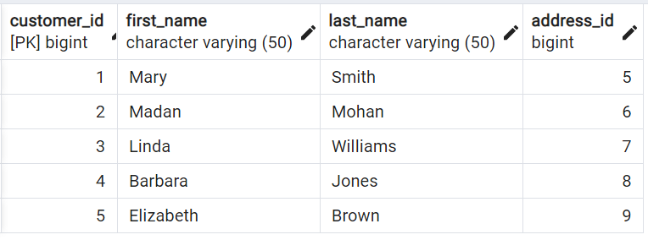
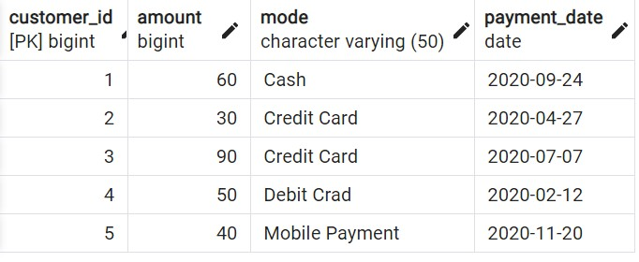
Question: How much amount was paid by customer ‘Madan’, what was mode and payment date?
Answer: Amount = 30, Mode = Credit Card, Date = 2020-04-27

Slide 47

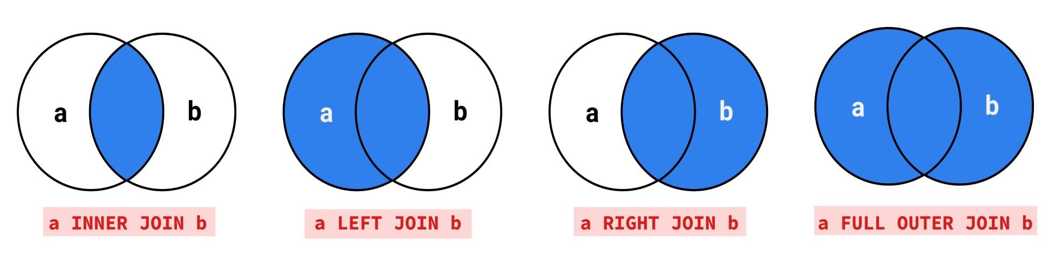
INNER JOIN
LEFT JOIN
RIGHT JOIN
FULL JOIN

Slide 48


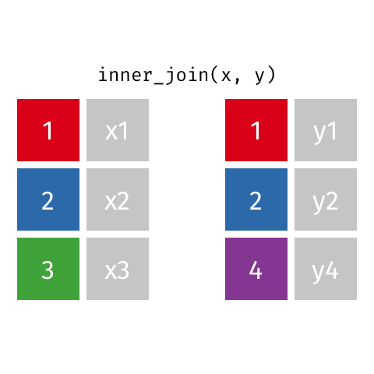
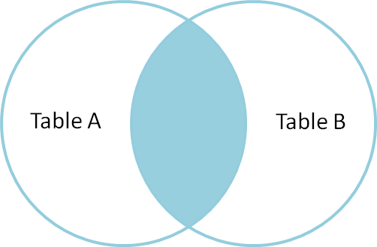
Returns records that have matching values in both tables

Slide 49
Syntax
SELECT column_name(s) FROM TableA
INNER JOIN TableB
ON TableA.col_name = TableB.col_name
Example
SELECT *
FROM customer AS c INNER JOIN payment AS p
ON c.customer_id = p.customer_id

Slide 50



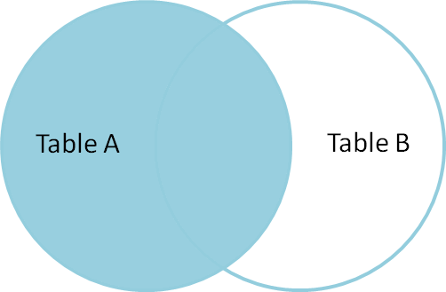
Returns all records from the left table, and the matched records from the right table

Slide 51
Syntax
SELECT column_name(s) FROM TableA
LEFT JOIN TableB
ON TableA.col_name = TableB.col_name
Example
SELECT *
FROM customer AS c LEFT JOIN payment AS p
ON c.customer_id = p.customer_id

Slide 52



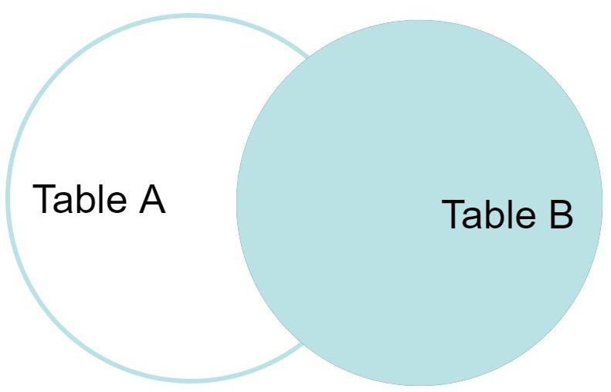
Returns all records from the right table, and the matched records from the left table

Slide 53
Syntax
SELECT column_name(s) FROM TableA
RIGHT JOIN TableB
ON TableA.col_name = TableB.col_name
Example
SELECT *
FROM customer AS c RIGHT JOIN payment AS p
ON c.customer_id = p.customer_id

Slide 54


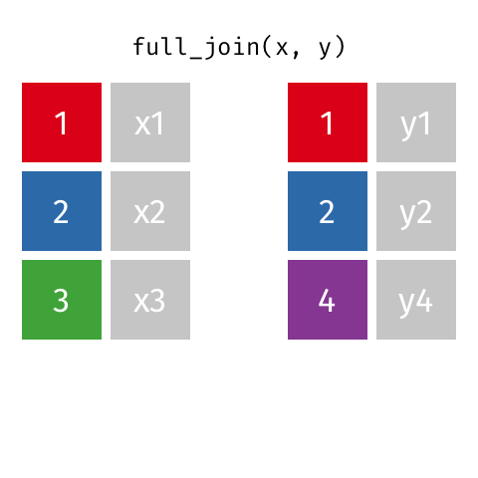
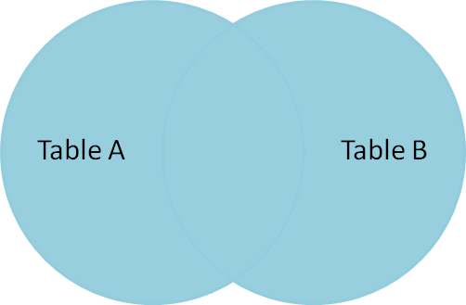
Returns all records when there is a match in either left or right table

Slide 55
Syntax
SELECT column_name(s) FROM TableA
FULL OUTER JOIN TableB
ON TableA.col_name = TableB.col_name
Example
SELECT *
FROM customer AS c
FULL OUTER JOIN payment AS p ON c.customer_id = p.customer_id

Slide 56

INNER JOIN: Returns records that have matching values in both tables
LEFT JOIN: Returns all records from the left table, and the matched records from the right table
RIGHT JOIN: Returns all records from the right table, and the matched records from the left table
FULL JOIN: Returns all records when there is a match in either left or right table

Slide 57
SELF JOIN

Slide 58

A self join is a regular join in which a table is joined to itself
SELF Joins are powerful for comparing values in a column of rows with the same table
Syntax
SELECT column_name(s) FROM Table AS T1
JOIN Table AS T2
ON T1.col_name = T2.col_name

Slide 59

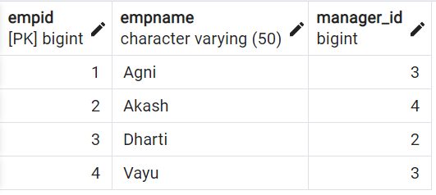
Table: emp
Find the name of respective managers for each of the employees?

Slide 60
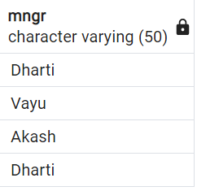
SELECT T2.empname, T1.empname
FROM emp AS T1 JOIN emp AS T2
ON T1.empid = T2.manager_id

Slide 61

The SQL UNION clause/operator is used to combine/concatenate the results
of two or more SELECT statements without returning any duplicate rows and keeps unique records
To use this UNION clause, each SELECT statement must have
The same number of columns selected and expressions
The same data type and
Have them in the same order
Syntax
SELECT column_name(s) FROM TableA UNION
SELECT column_name(s) FROM TableB
Example
SELECT cust_name, cust_amount from custA
UNION
SELECT cust_name, cust_amount from custB

Slide 62

In UNION ALL everything is same as UNION, it combines/concatenate two or more table but keeps all records, including duplicates
Syntax
SELECT column_name(s) FROM TableA UNION ALL
SELECT column_name(s) FROM TableB
Example
SELECT cust_name, cust_amount from custA
UNION ALL
SELECT cust_name, cust_amount from custB

Slide 63

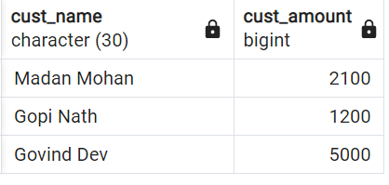
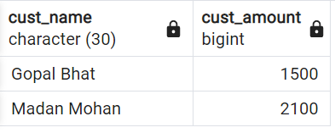
Table: custB
Table: custA

Slide 64
Study Material: 1. https://www.w3schools.com/sql/ 2. https://www.tutorialspoint.com/sql/index.htm 3. https://www.javatpoint.com/sql-tutorial 4. https://youtu.be/pVKT4N-Cgb8 5. https://www.youtube.com/watch?v=LGTbdjoEBVM

Slide 65
Install SQL Server
(Postgre SQL Installation And SQL PLUS)

Slide 66
Install SQL Server
PostgreSQL :
Download link: https://www.enterprisedb.com/downloads/postgres-postgresql-downloads
Installation Guide: https://youtu.be/MTRtusym-2s
2. SQL-Plus:
Download and Installation Guide: https://youtu.be/pfIIaCp3IzQ

Slide 67
TASKS
Download Postgres
Download SQL-Plus
Study Window Function and CTE
Create Classroom or Course, Student and Teacher tables and perform joins operation on it.
Perform joins, union, aggregate function, group by, insert, update etc. on any tables created by you and perform at least 10 SQL queries on them.
Example: 1. Find the names of students not enrolled in any class.
2. Find the names of faculty members for whom the combined enrollment of the courses that they teach is less than five.
3. Print the faculty member’s name and the total number of classes she or he has taught. etc
You need to write different SQL queries (at least ten) on the tables created by you.

Slide 68
Thank You.

